Slide 2
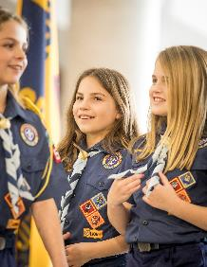
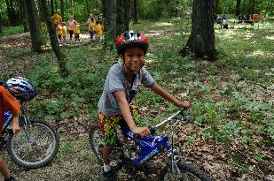
What is Cub Scouting?
• Program for boys and girls kindergarten - 5th grade
• Builds Character
• Teaches Citizenship
• Strengthens Families
• Tons of FUN!
Parent Orientation Guide pages 3-5

Slide 3
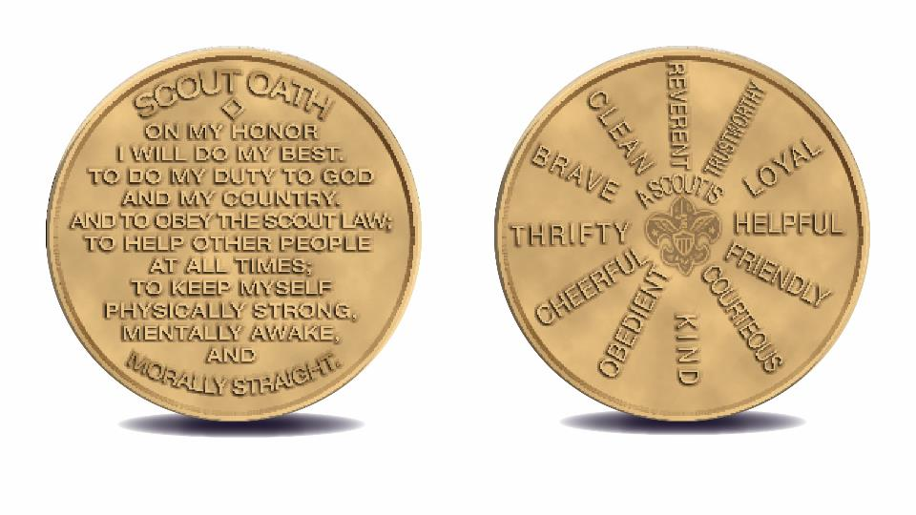
Scout Oath & Scout Law
Parent Orientation Guide page 6

Slide 4
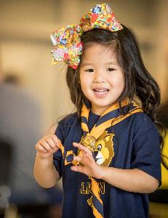
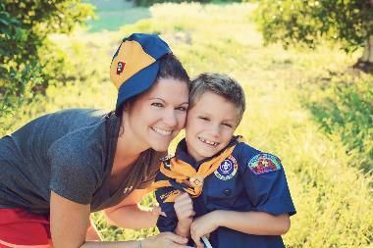
What Parents Want
^{• Bring the family together}
• Help their children develop skills and leadership
^{• Connect with other parents}
^{• Learn to get along}
^{• Build self-confidence}
^{• Be happy and have fun!}
Parent Orientation Guide page 7

Slide 5
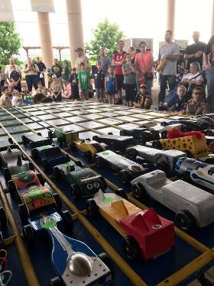
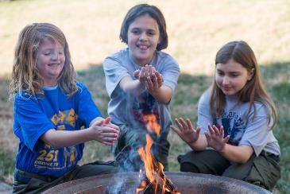
What Scouts Want
^{• FUN!}
^{• Make new friends}
^{• Master new skills}
^{• Recognition and praise}
^{• FUN!}
Parent Orientation
Guide page 7

Slide 6
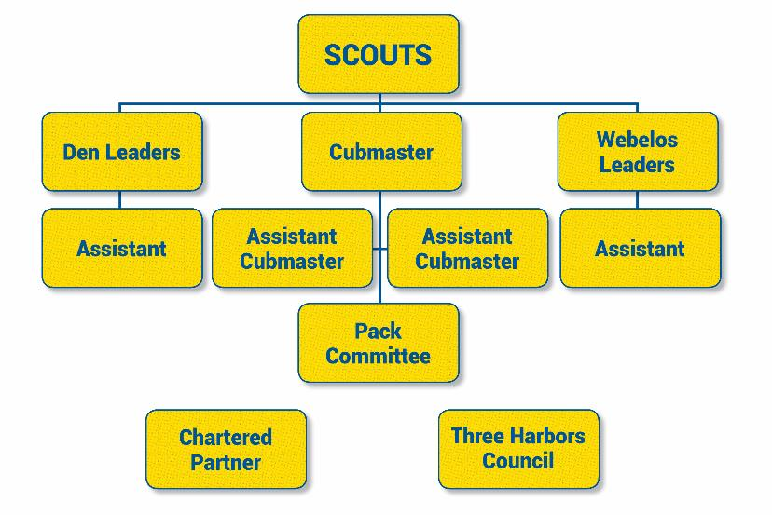
Pack Organization
Parent Orientation
Guide page 8

Slide 7
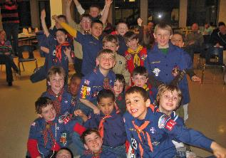
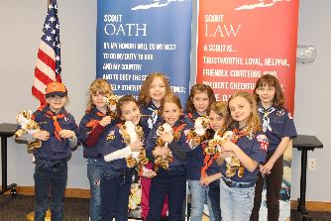
How Does it Work?
Den Meetings: small groups organized by grade & gender
Program Delivery: meeting tips, den meeting lesson plans, new den leader experience
Pack Meetings & Activities: family events combining all dens
Scout Life/Handbook/Uniform: the basics
Advancement: celebrating achievement and building self confidence
Special Programs, Events & Community Service: Scouting for Food, ^{Haunted Hayride, and Day Camp}
Parent Orientation Guide pages 9-14

Slide 8
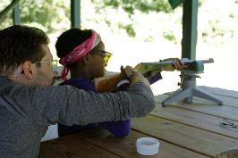
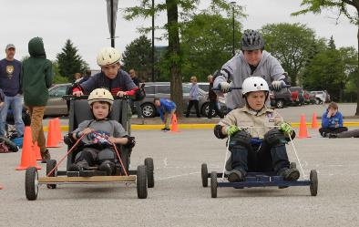
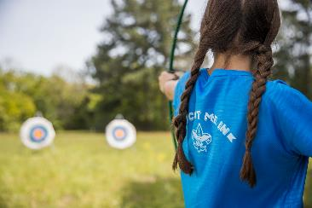
Parent Participation
Scoutbook
Volunteering & Leadership opportunities for parents
Additional Resources
Parent Orientation Guide pages 15-16

Slide 9
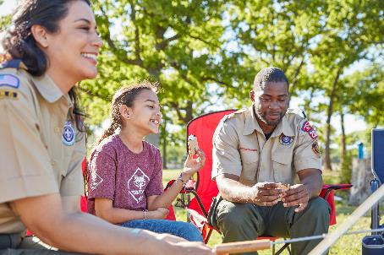
Volunteer Leader Training
Available online at My.Scouting.org
Youth Protection Training
Position Specific
Roundtable
Parent Orientation
Guide page 17

Slide 10
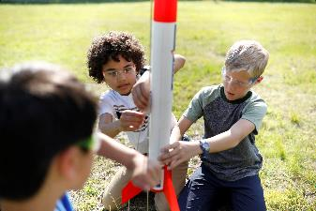
Finance
Registration Fees
Dues / Uniform
Money Earning Projects
Friends of Scouting
United Way Support
Limited Council membership assistance
Parent Orientation Guide pages 18-20

Slide 11
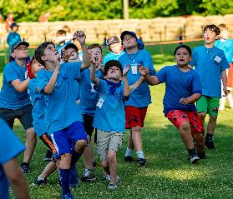
Pack Details
Calendar
Leader Roster
Pack Website/Facebook Page
Scoutbook
Collect Family Talent Surveys
Family Commitment/Volunteering Opportunities
Time Commitment
Pack Dues
Parent Orientation
Guide page 23

Slide 12
Registration
To Register Scouts:
Completed form tonight
Completed online registration tonight
Registration & joining fee
Scout Life Subscription (recommended)
To Register Adults:
Completed form, proper signatures and training
Registration fee: insurance, training costs, and Scouting magazine subscription are included.
*Make checks payable to unit for all registrations

