Slide 1
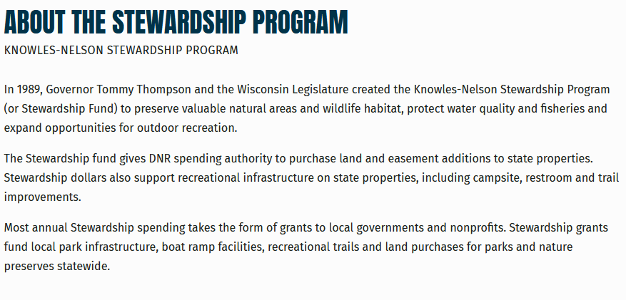
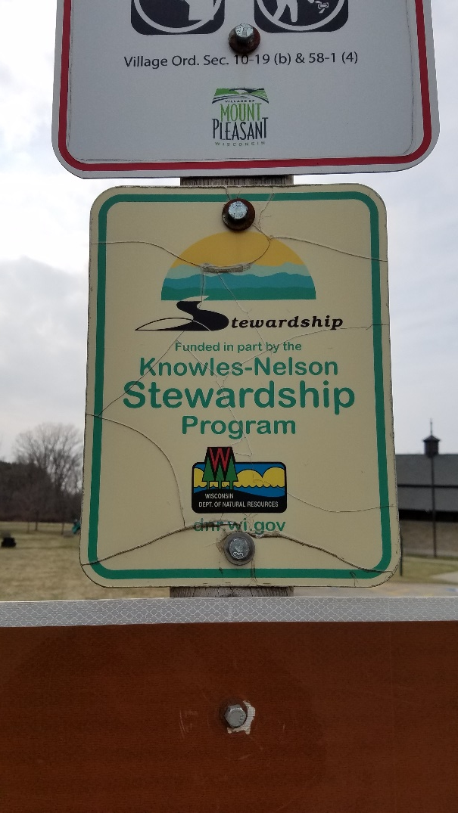
Knowles – Nelson Stewardship Program

Slide 2
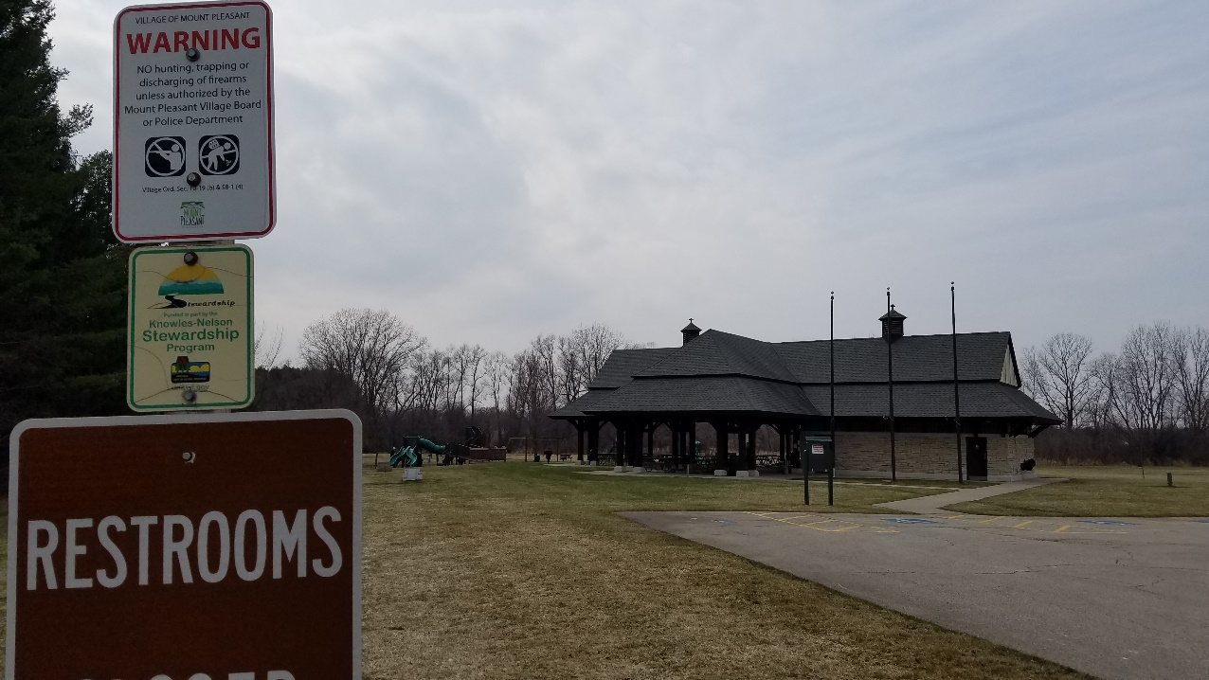
Knowles – Nelson Stewardship Program
The Program is due for renewal in 2021 by the Wisconsin Legislature
Why should you care?
Program supports projects in our area:
Pike river bike paths
Smolenski park

Slide 3
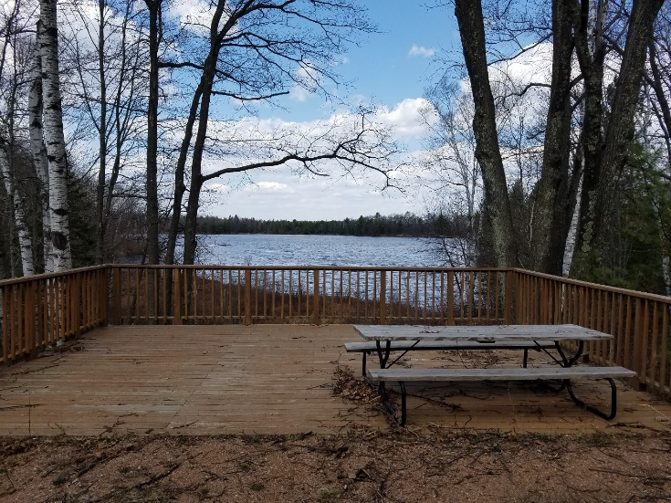
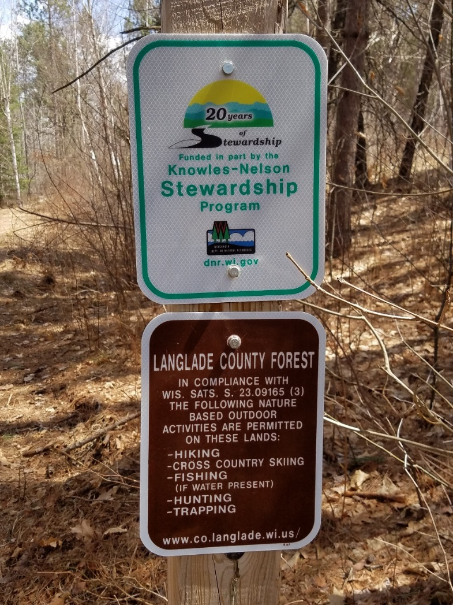
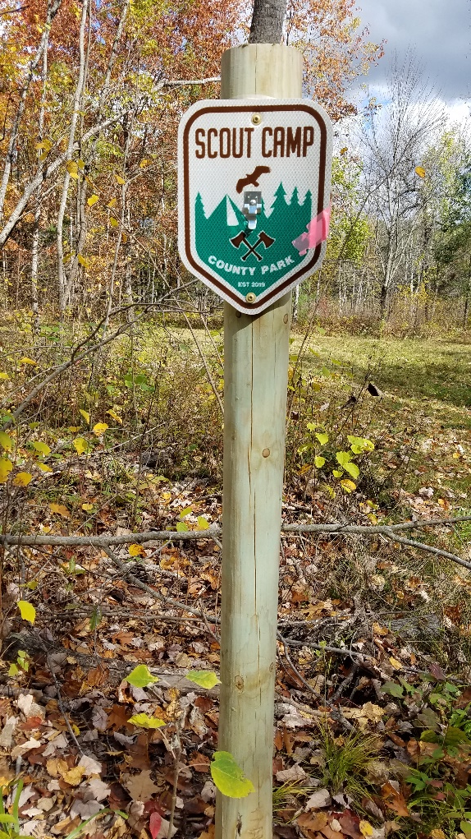
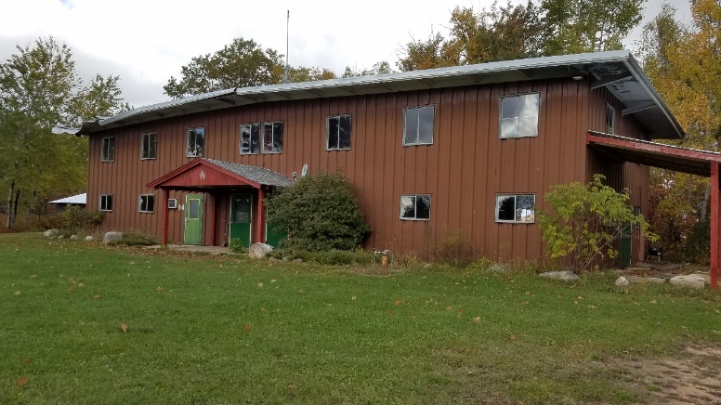
Knowles – Nelson Stewardship Program
Program supports a park project in Langlade County

Slide 4
Knowles – Nelson Stewardship Program
What can you do?
Write to your Wisconsin elected Representatives.
Ask them to renew the Program for another 10 year term
Ask them to fully fund the Program
Maybe a good Citizenship in the Community project?
We’re all busy, so here’s a link to a form letter for your Representatives:
https://www.nature.org/en-us/about-us/where-we-work/united-states/wisconsin/stories-in-wisconsin/knowles-nelson-stewardship-program/
More info
https://dnr.wisconsin.gov/topic/Stewardship
https://www.ncwrpc.org/langlade/orp/1%20Langlade%20ORP%202017-2021_Adopted_OnWeb.pdf

