Slide 1
Notes:
Slide 1: Welcome
Begin at the scheduled start time; introduce yourself and key pack leaders
Ensure all families have signed-in, have an Onboarding Packet and are seated by grade
Review the purpose of tonight’s meeting:
Provide basic information about Cub Scouting
Enroll your child(ren) in Cub Scouting
Provide key dates for upcoming Pack meetings
Invite them to upcoming council Cub Scout activities

Slide 2
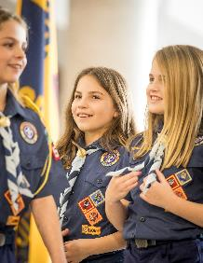
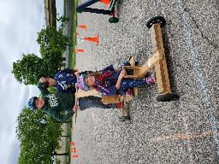
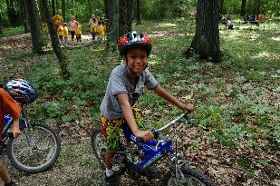
What is Cub Scouting?
• Program for boys and girls kindergarten - 5th grade
• Builds Character
• Teaches Citizenship
• Strengthens Families
• Tons of FUN!
Parent Orientation Guide pages 3-5
Notes:
Slide 2: What is Cub Scouting
Program for elementary-age youth and their families. Through activities and meetings, youth are involved in a program which focuses on Character Development, Participatory Citizenship, Personal Fitness, Outdoor Skills & Awareness, and Leadership & Life Skills. Let’s not forget that the youth… and adults have FUN!

Slide 3
Scout Oath & Scout Law
Parent Orientation Guide page 6
Notes:
Slide 3: Scout Oath & Scout Law
The Scout Oath and Law have guided the Boy Scouts of America for more than 110 years and help emphasize the bedrock principles by which we expect every participant to live their entire lifetime by.

Slide 4
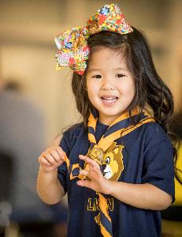
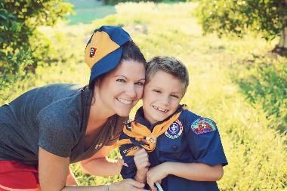
What Parents Want
^{• Bring the family together}
• Help their children develop skills and leadership
^{• Connect with other parents}
^{• Learn to get along}
^{• Build self-confidence}
^{• Be happy and have fun!}
Parent Orientation Guide page 7
Notes:
Slide 4: What Parents Want
Cub Scouting is a great way to have positive personal and family experiences together. Your children will gain skills and leadership abilities they would not otherwise gain. You’ll have the chance to know and work with parents of the other children in your child’s class and school. Finally, you’ll see your child learn cooperation and self-confidence in Cub Scouting.

Slide 5
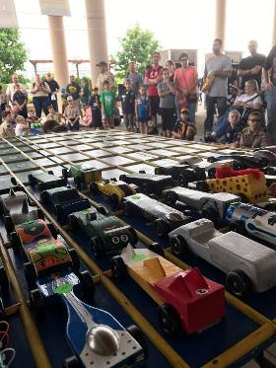
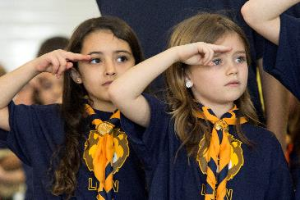
What Scouts Want
^{• FUN!}
^{• Make new friends}
^{• Master new skills}
^{• Recognition and praise}
^{• FUN!}
Parent Orientation
Guide page 7
Notes:
Slide 5: What Scouts Want
Your children are looking for FUN. Cub Scouting will provide many opportunities for fun. Along the way, your child will make new friends and learn a lot of new skills. Everything in the Cub Scouting program is designed to help their personal growth and those advancements are recognized regularly. And it’s all FUN!

Slide 6
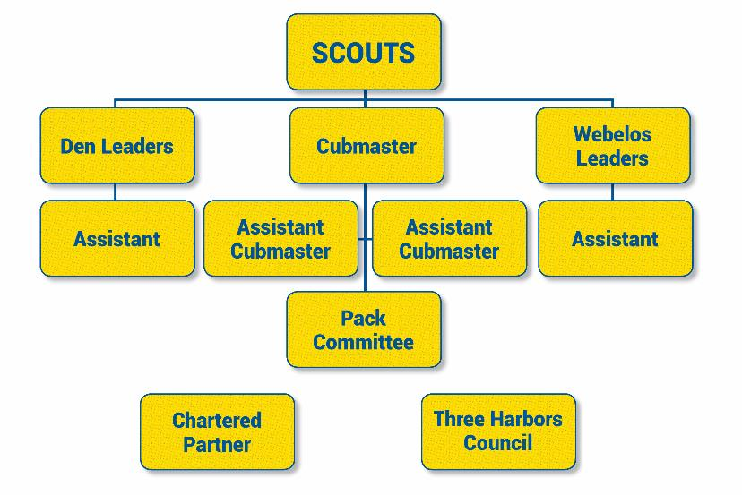
Pack Organization
Parent Orientation
Guide page 8
Notes:
Slide 6: Pack Organization
Organization chart that shows basic structure of a Cub Scout Pack.

Slide 7
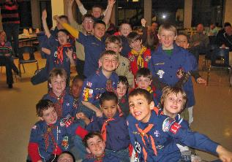
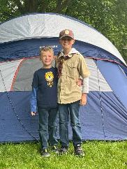
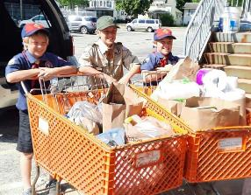
How Does it Work?
Den Meetings: small groups organized by grade & gender
Program Delivery: meeting tips, den meeting lesson plans, new den leader experience
Pack Meetings & Activities: family events combining all dens
Scout Life/Handbook/Uniform: the basics
Advancement: celebrating achievement and building self confidence
Special Programs, Events & Community Service: Scouting for Food, Scouting the Zoo, ^{Haunted Hayride, and Day Camp}
Parent Orientation Guide pages 9-14
Notes:
Slide 7: How Does it Work?
Key programs that make Cub Scouts and their families successful in Scouting.

Slide 8
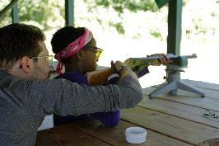
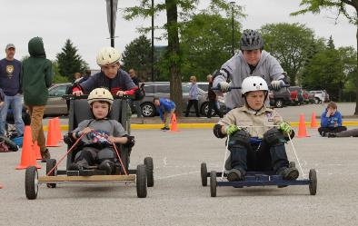
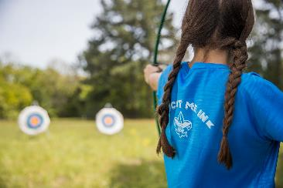
Parent Participation
Scoutbook
Volunteering & Leadership opportunities for parents
Additional Resources
Parent Orientation Guide pages 15-16
Notes:
Slide 8: Parent Participation
Discuss parent/family participation in Cub Scouting. The Pack is made up of all volunteer leaders providing the Cub Scouting program. We are all parents, just like you, who got involved and learned how to make the program exciting for our children.
“Cub Scouts is an adventure you take with your child; it is NOT a spectator sport!”

Slide 9
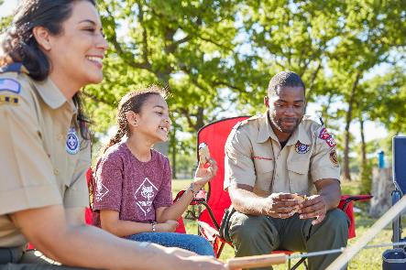
Volunteer Leader Training
Available online at My.Scouting.org
Youth Protection Training
Position Specific
Roundtable
Basic training online or in-person
Outdoor skills and advanced training when ready
Parent Orientation
Guide page 17
Notes:
Slide 9: Volunteer Leader Training
My.scouting.org
Youth Protection Training
Position-specific leader training
Roundtable
Ongoing basic and supplemental training

Slide 10
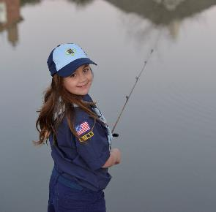
Finance
Registration Fees
Dues / Uniform
Money Earning Projects
Friends of Scouting
United Way Support
Parent Orientation Guide pages 18-20
Notes:
Slide 10: Finance
BSA membership fee is $75/year, pro-rated at $6.25/month. There is also a one-time joining fee of $25. These will be collected tonight.
The uniform is a key method of the BSA and helps young people feel a shared identity with each other as part of Scouting. A new uniform, including uniform pants and belt, and the corresponding youth handbook totals approximately $110. Without the pants and belt, these total approximately $65.
Some packs may collect dues to cover the cost of Pack activities, supplies and other operating costs. Pack leadership here tonight can address that for you.
The council offers several approved money-earning projects including popcorn sales and wreath sales in the fall, and camp card sales in the spring. Units may participate in their own money-earning projects which must be approved by the council. Money earned from these projects help teach youth key Scouting lessons such as salesmanship and courtesy and can be used to help offset the direct cost to families for their Scouting experience.
Friends of Scouting takes place each winter and is an optional program where families are asked to make tax-deductible contributions directly to the council to support programs and services available from Three Harbors Council directly to Scouting units.
The United Way supports Three Harbors Council. Your contribution to the United Way indirectly helps the council offer programs and services directly to Scouting units.

Slide 11
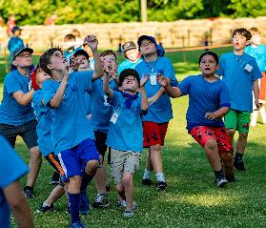
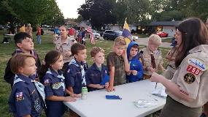
Pack Details
Calendar
Leader Roster
Pack Website/Facebook Page
Scoutbook
Collect Family Talent Surveys
Family Commitment/Volunteering Opportunities
Time Commitment
Pack Dues
Parent Orientation
Guide page 23
Notes:
Slide 11: Pack Specific Information
Conducted by Pack leaders on site (3-5 minutes)
Distribute copy of Pack 2022-23 calendar & leader roster
Share date/time/location of the next Pack Meeting
Collect completed Family Talent Surveys
Time Commitment: 2-4 meetings/month, about one hour in length each (2-3 den meetings, one Pack Meeting) and other activities/outing as available
Family Commitment: An adult must attend meetings with youth as Lions & Tigers, adults should attend all Pack Meetings with youth, all Pack leadership comes from parent volunteers
Share brief overview of volunteering opportunities in the Pack that can be discussed and committed to at a later date
Share dues information including amount, what is covered by dues, when it is due to be paid to the pack, and opportunities to offset direct payment through money-earning projects

Slide 12
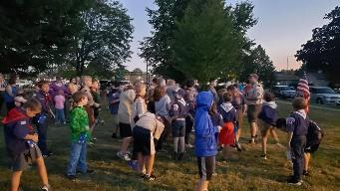
Registration
To Register Scouts:
Completed form tonight
Completed online registration tonight
Registration & joining fee
Scout Life Subscription (additional fee) (recommended)
To Register Adults:
Completed form, proper signatures and training
Registration fee: insurance, training costs, and Scouting magazine subscription are included.
*Make checks payable to unit for all registrations
Notes:
Slide 12: Registration
Completing the registration form and paying registration fees tonight.

